Slide 1




Diwali Sales
Analysis
Using Python go to depth of data

Slide 2





Table of
Contents
01
Introduction
02
Data Structure
03
Data Cleaning
04
Visualization
05
Data depth
06
conclusion

Slide 3




INTRODUCTION
The Diwali Sales Analysis Dataset offers insights into consumer behavior and sales trends during the Diwali festival. Analysts can determine which products sold the most, identify the states with the highest purchases, and analyze the buying habits of different occupations. Additionally, the dataset allows for a comparison of shopping patterns between male and female consumers, making it a valuable tool for retailers and marketers aiming to optimize their strategies during this peak shopping season.

Slide 4


DATA STRUCTURE

Slide 5
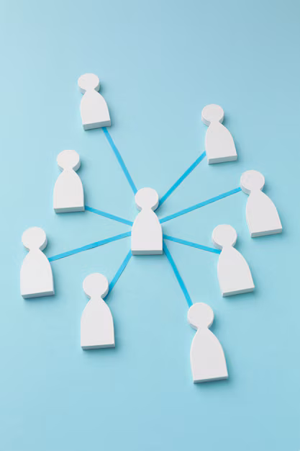
Diwali Data Analysis Column
User_ID: Unique identifier for each customer.
Cust_name: Name of the customer.
Product_ID: Unique identifier for each product.
Gender: Gender of the customer.
Age Group: Age group of the customer.
Age: Age of the customer.
Marital_Status: Marital status of the customer.
State: State where the transaction occurred.
Zone: Zone classification based on the state.
Occupation: Occupation of the customer.
Product_Category: Category of the purchased product.
Orders: Number of orders placed by the customer.
Amount: Total amount spent by the customer.

Slide 6

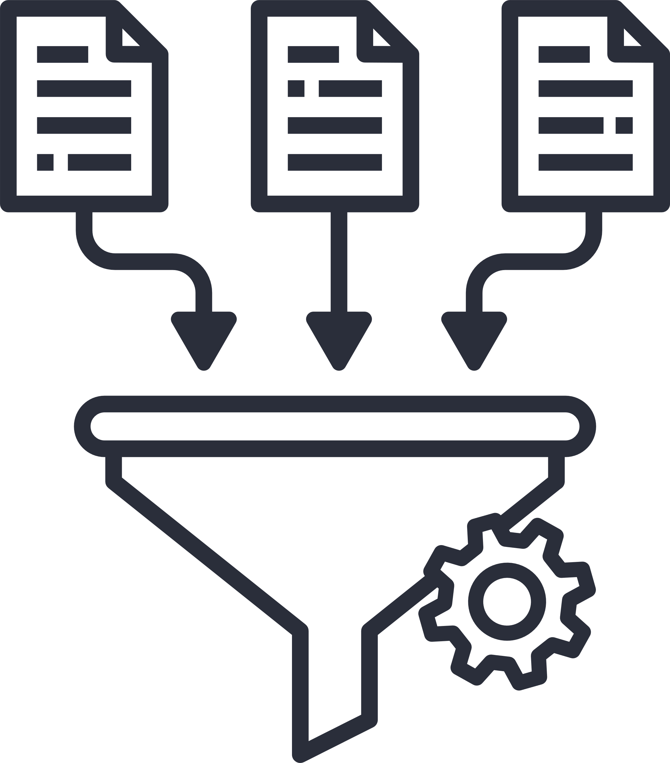
Data Cleaning
Removing errors and inconsistencies from data.

Slide 7




Action:
Null Values: Identify and address null values to ensure complete data.
Missing Values: Detect and handle missing values to avoid gaps in analysis.
Data Type Consistency: Ensure all data types are consistent and correct.
Correct Errors: Identify and fix errors to maintain dataset accuracy and reliability.

Slide 8

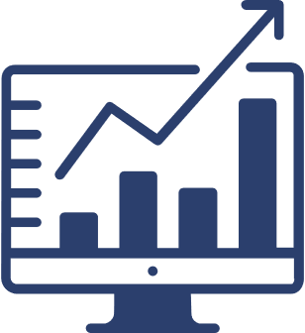
Visualization

Slide 9

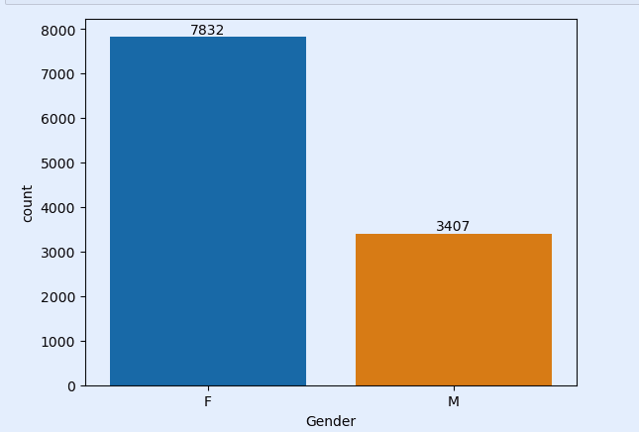
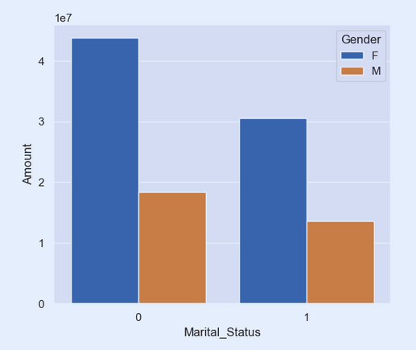
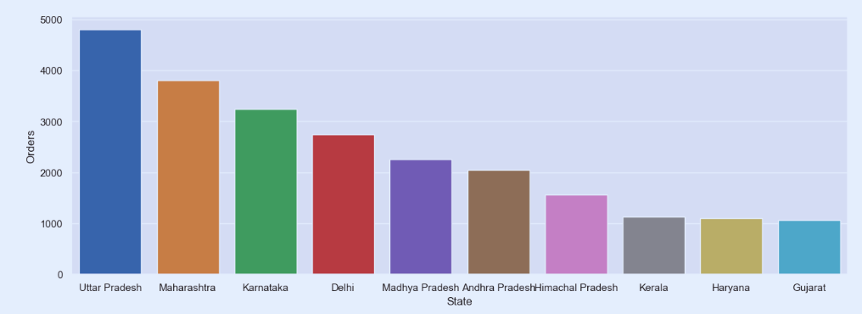

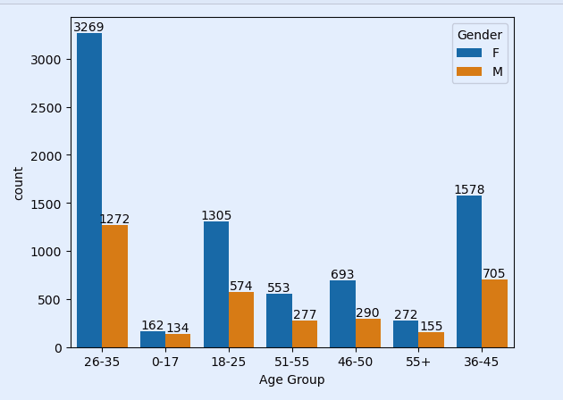
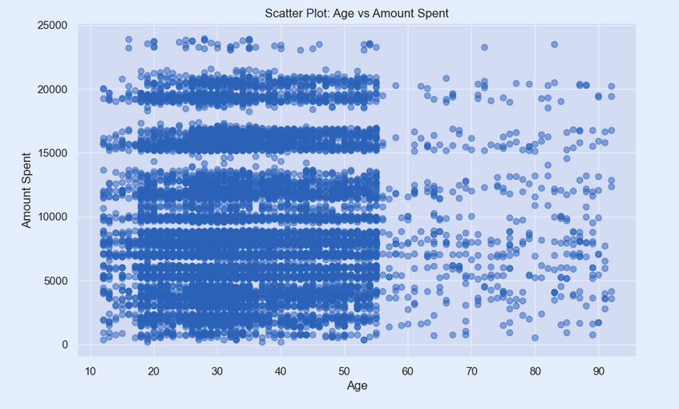
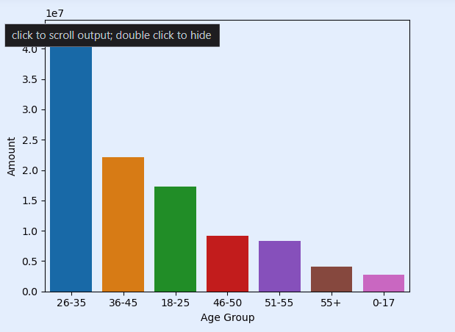
Graph

Slide 10
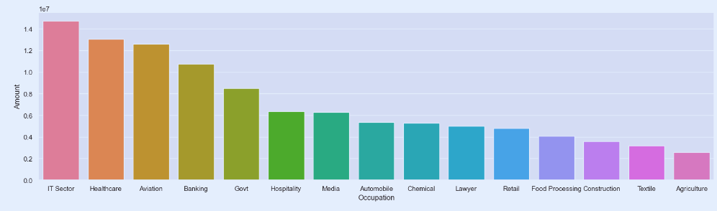
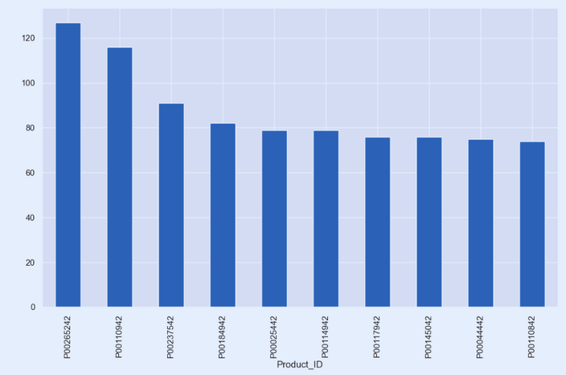
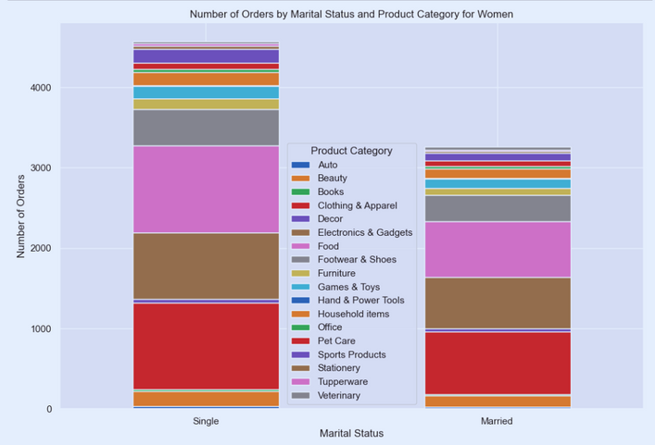
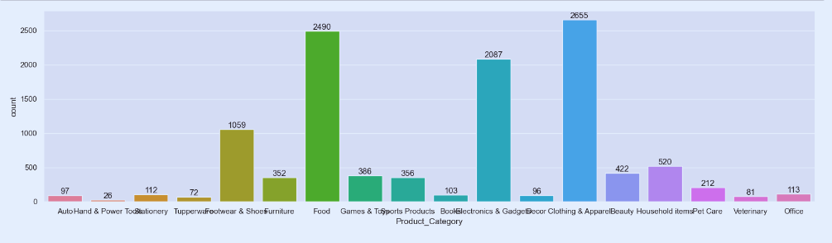
Graph

Slide 11


Data Depth
refers to understanding, analyzing, and deriving insights from data.

Slide 12


1. Married women aged 26-35 from Uttar Pradesh, Maharashtra, and Karnataka, working in IT, Healthcare, and Aviation, are more likely to buy products from the Food, Clothing, and Electronics categories.
2. Women shop more frequently than men.
3. The most sellable product during the Diwali Sales is P00265242.
4. Most unmarried women have pets.
5. Retail stores are frequented mainly by people from healthcare centers.
6. People working in the IT sector exhibit high purchasing power.

Slide 13
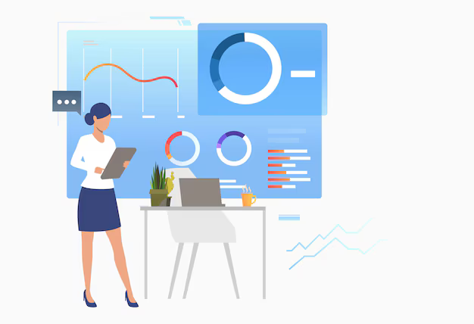
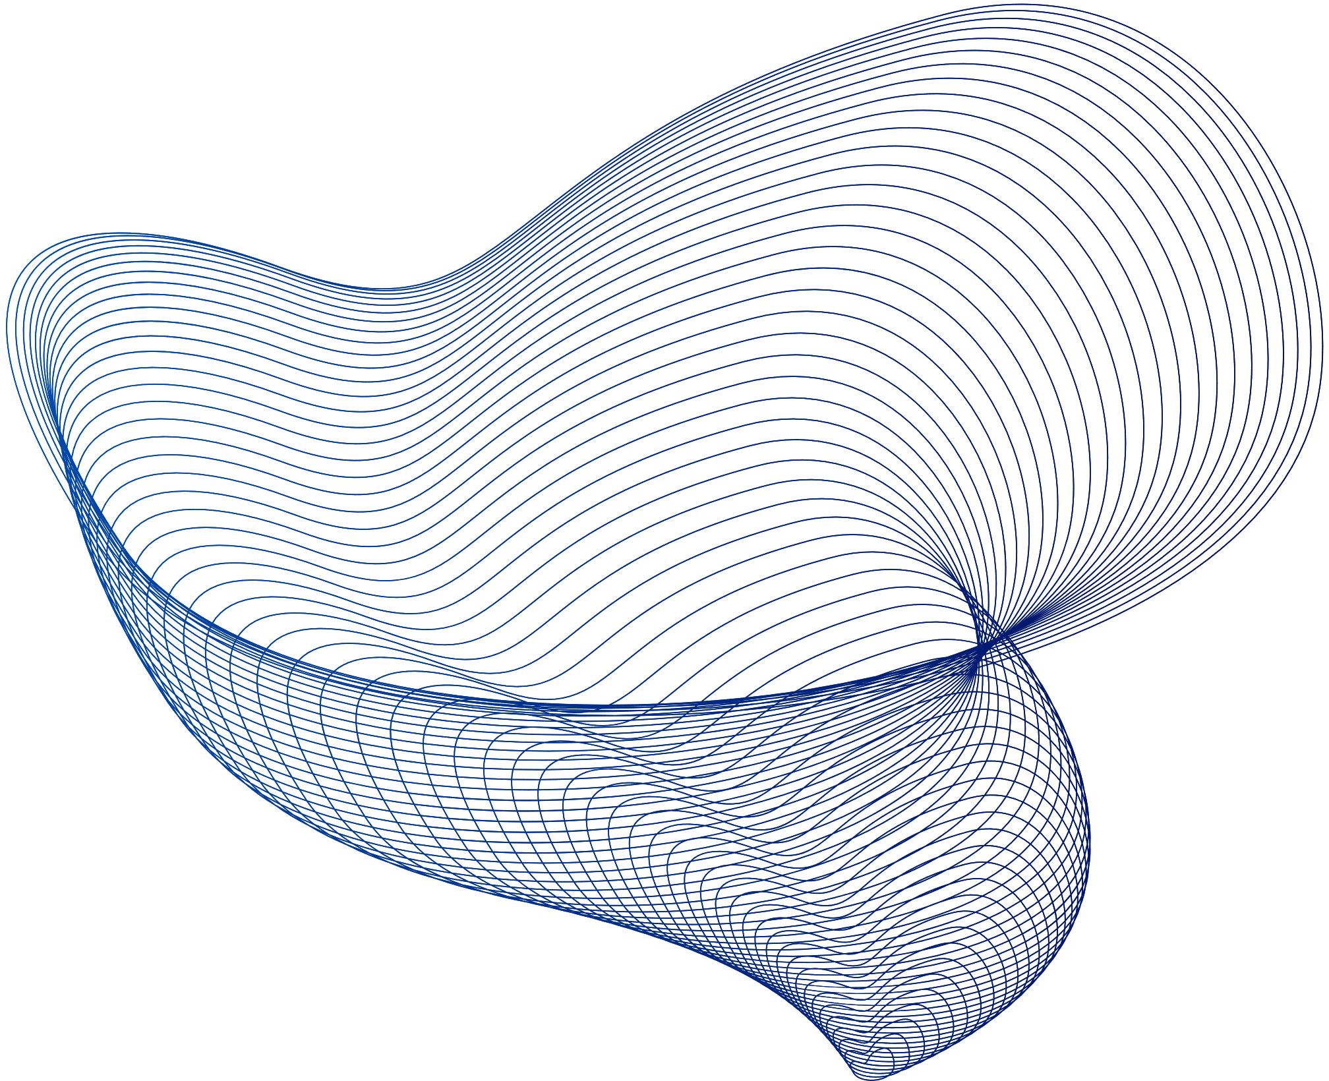

conclusion
The Diwali Sales Analysis Dataset is a robust and versatile resource for anyone interested in retail sales and consumer behavior during the Diwali festival. By providing detailed and up to-date information, it supports a wide range of applications from sales analysis to marketing strategy. This concept note highlights the dataset's key features and potential uses, encouraging its adoption and effective utilization in various contexts

Slide 14

Thank You!
Do you have any type of questions regarding to this Project
feel free to send a message on LinkedIn?

